Slide 1
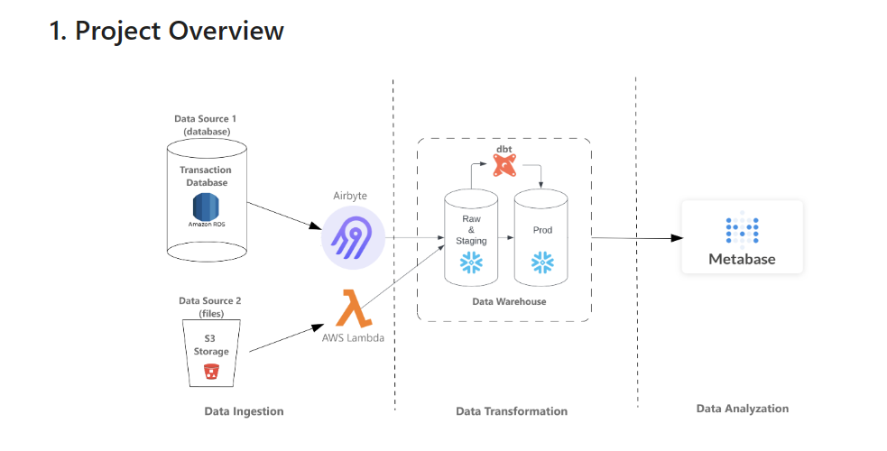
PHASE 1 – Project Presentation
Kha Pham

Slide 2
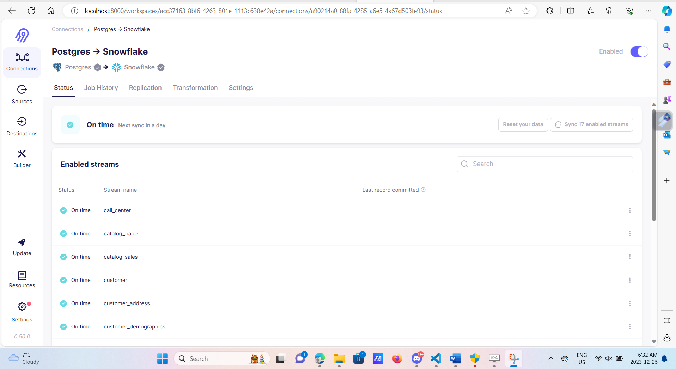
Data Ingestion using Airbyte

Slide 3
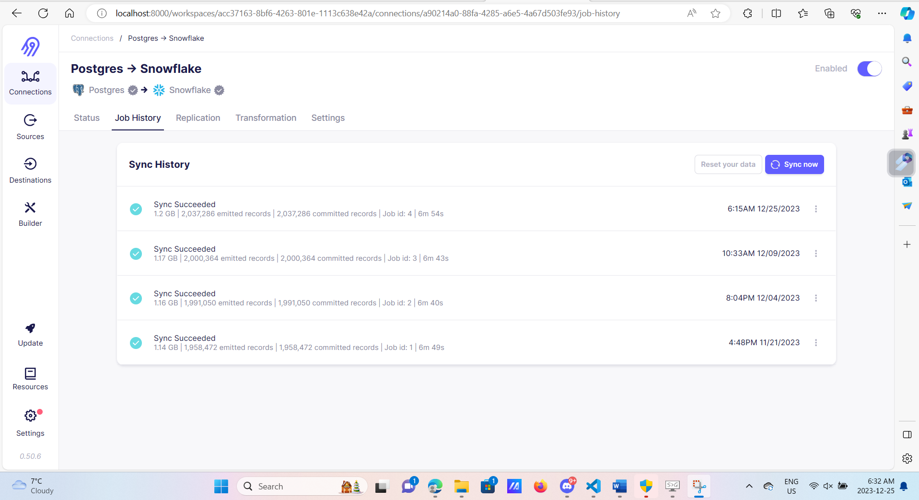
Data Ingestion using Airbyte

Slide 4
Data Ingestion using AWS Lambda

Slide 5
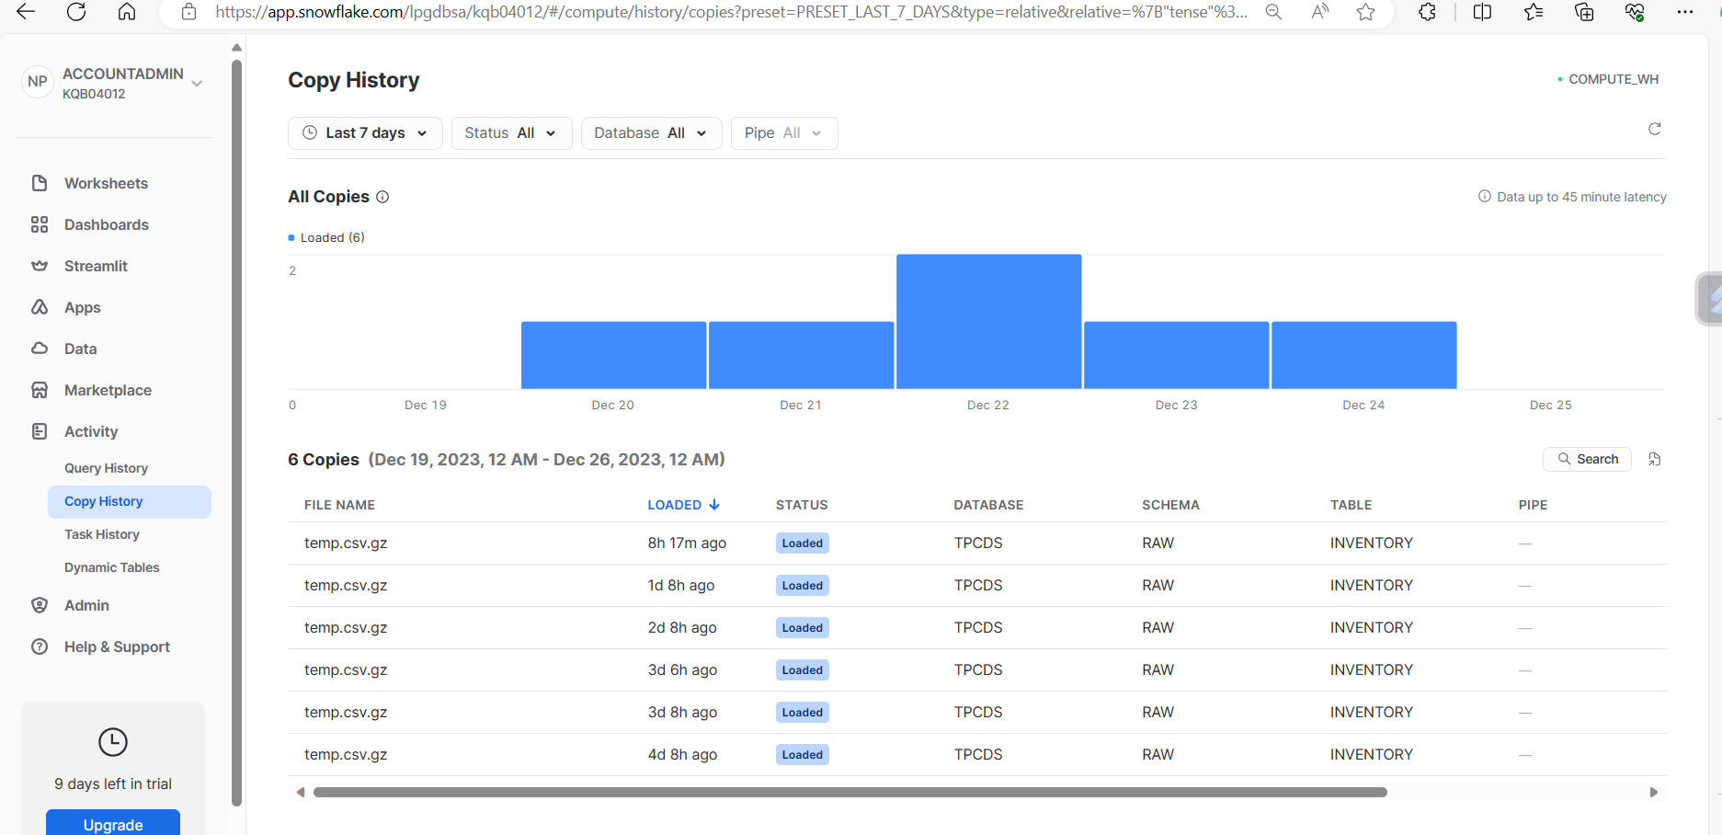
Data Ingestion using AWS Lambda

Slide 6
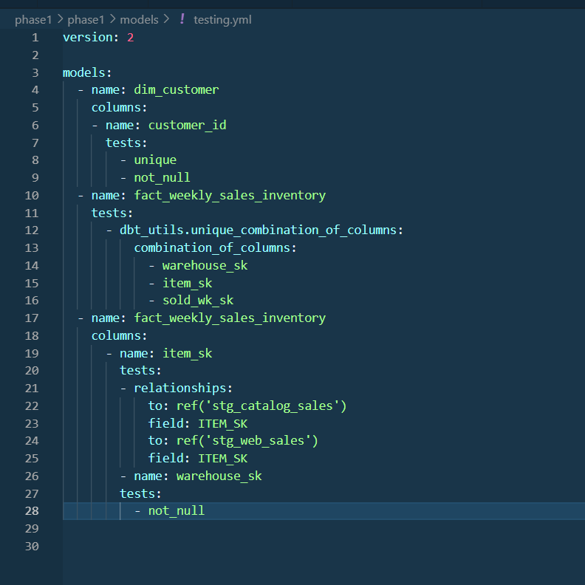
Testing

Slide 7
Data Transformation using dbt

Slide 8
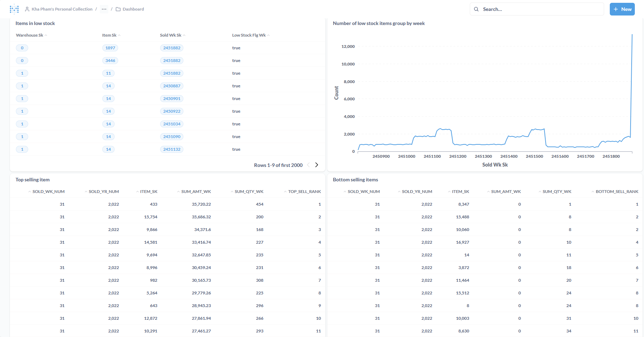

Slide 9
Testing

